Slide 1

Quantum Simulation of the 1D Burgers’ Equation
WISER Quantum Project
Presented by:
Nandan Patel
Isshaan Singh

Slide 2
Goal of the project
WISER Quantum Project
Simulating 1D Burger’s equation efficiently using quantum algorithms
Develop advanced quantum pipeline with classical pre and post processing to efficiently simulate the equations
Integrate the boundary constraints and ensure that the equation complexity is reduced
Ensure that the model is scalable and the errors do not accumulate too much

Slide 3
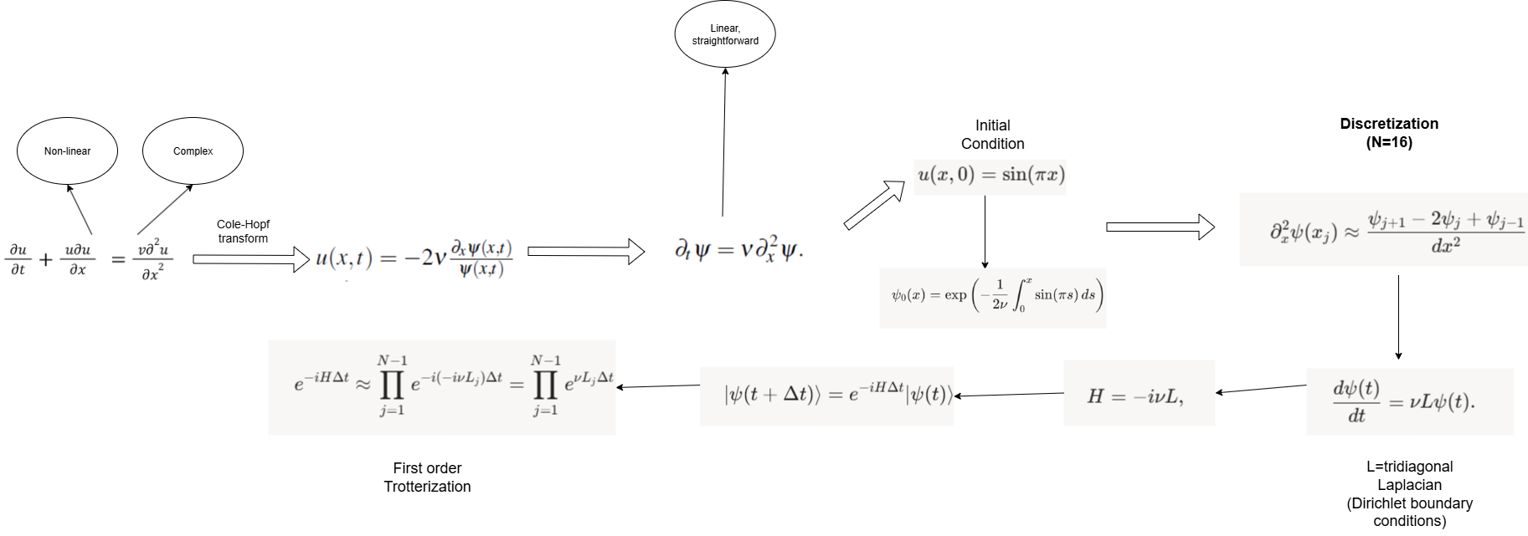
WISER Quantum Project
Architecture of the model

Slide 4
Cole-Hopf Transform
WISER Quantum Project
It is a mathematical technique used to convert the nonlinear Burgers’ equation into a linear heat equation.
By applying a specific transformation to the dependent variable, it simplifies the problem, allowing for exact analytical solutions.
In our project: It converts Burgers equation 1D Heat Equation
Inspiration: Onuoha, N. O. (2023). Transformation of Parabolic Partial Differential Equations into Heat Equation Using Hopf Cole Transform. International Journal of Science and Research. https://doi.org/10.21275/sr23612082710

Slide 5

Initial Condition
WISER Quantum Project
Given initial Condition:
Prone to shocks, at high Re numbers,
Our initial condition:
Smoothens out the curve, absorbs shocks well

Slide 6

Discretization
WISER Quantum Project
Laplacian matrix: 16x16 tridiagonal matrix(Following Dirichlet Conditions)
Discretize into 16 points
Use second-order finite difference to get an approximation of the wavefunction

Slide 7

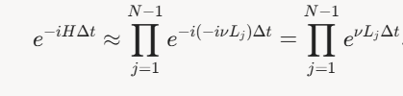
Time-evolution and Trotterization
WISER Quantum Project
Time evolution is followed as:
With the value of H = -ivL
Trotterize the circuit into N=20 steps and decompose the unitary evolution:

Slide 8


ZNE
WISER Quantum Project
Basically running the circuit at different noise levels and then using those to extrapolate it to zero to get an idea of the circuit at that level
We use a linear model to calculate the errors at specific points
Decreases circuit depth and L2 errors by about 20%

Slide 9



Recovering the velocity
WISER Quantum Project
Calculate the wavefunction:
Using the Cole-Hopf transform, compute:
Approximated using second order finite difference

Slide 10

Classical Benchmark
WISER Quantum Project
We use a classical Krylov-based solver to compare our solution spanned by:
We use Lanczos iterations for orthogonalization(since L is symmetric):

Slide 11
Results and Parameters
WISER Quantum Project
Metrics used: L2 Errors, Dissipation Rates, Shock position, Circuit depth
Compared the u(x,t) value for 6 time steps, for 3 methods: Classical, Noisy Quantum, ZNE Quantum
Parameters defined:
Grid size(N) = 16
Qubits(logN) = 4
Discretization points = 16
uL = 1
uR = 0
shots = 8192
viscosity(ѵ) = 0.1

Slide 12
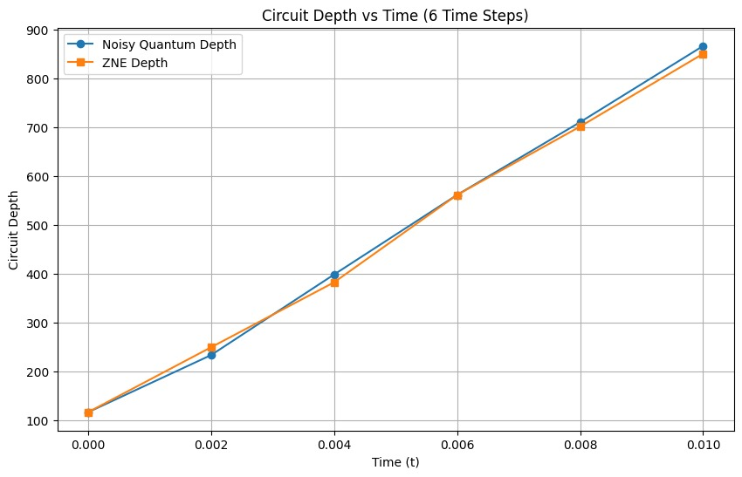
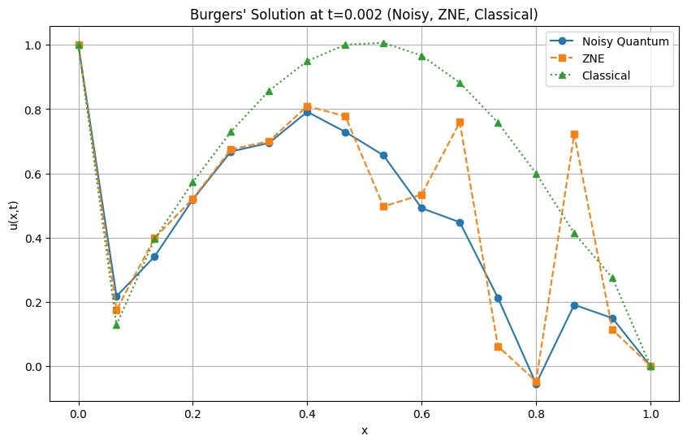
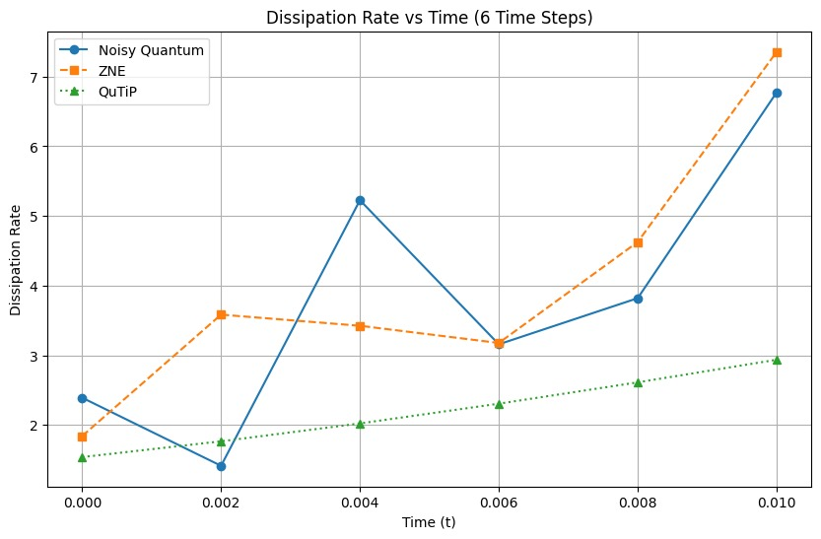
Plots
WISER Quantum Project

Slide 13
Conclusions and future work
WISER Quantum Project
Cole-Hopf transform along with Trotterization preserve the dynamics of the 1D Burger’s equation, removing non-linearity in the process
For initial time steps, ZNE is sufficient to suppress errors
This method reduces complexity and runtime compared to the Madelung transform
Better error mitigating protocols are required for higher time steps and more qubits
This model is dependent on the shock absorbent initial value, for high Re numbers, the model would highly depend on the choice of the initial value
Conclusions
Future Works

